Slide 1
Neural Networks
Marziyeh Mousavi
Introduction to datascience
Fall 2024

Slide 2
What is a Binary Classifier in Machine Learning?
A binary classifier in machine learning is a type of model that is trained to classify data into one of two possible categories, typically represented as binary labels such as 0 or 1, true or false, or positive or negative. For example, a binary classifier may be trained to distinguish between spam and non-spam emails, or to predict whether a credit card transaction is fraudulent or legitimate.

Slide 3
What is a Binary Classifier in Machine Learning?
Binary classifiers are a fundamental building block of many machine learning applications, and there are numerous algorithms that can be used to build them, including logistic regression, support vector machines (SVMs), decision trees, random forests, and neural networks. These models are typically trained using labeled data, where the correct label or category for each example in the training set is known, and then used to predict the category of new, unseen examples.

Slide 4
What is a Binary Classifier in Machine Learning?
The performance of a binary classifier is typically evaluated using metrics such as accuracy, precision, recall, and F1 score, which measure how well the model is able to correctly identify positive and negative examples in the data. High-quality binary classifiers are essential for a wide range of applications, including natural language processing, computer vision, fraud detection, and medical diagnosis, among many others..

Slide 5
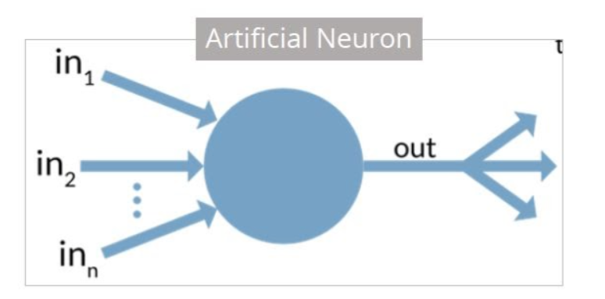
Artificial Neuron
An artificial neuron is a mathematical function based on a model of biological neurons, where each neuron takes inputs, weighs them separately, sums them up and passes this sum through a nonlinear function to produce output.
Image taken form simplilearn

Slide 6
Artificial Neuron
The artificial neuron has the following characteristics:
A neuron is a mathematical function modeled on the working of biological neurons
It is an elementary unit in an artificial neural network
One or more inputs are separately weighted
Inputs are summed and passed through a nonlinear function to produce output
Every neuron holds an internal state called activation signal
Each connection link carries information about the input signal
Every neuron is connected to another neuron via connection link

Slide 7
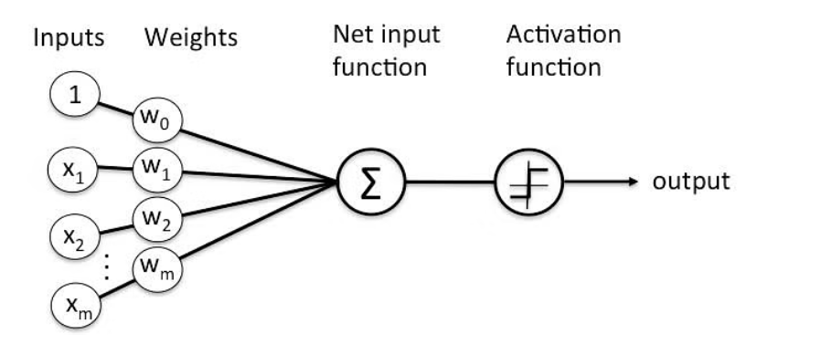
Perceptron
A Perceptron is an algorithm for supervised learning of binary classifiers. This algorithm enables neurons to learn and processes elements in the training set one at a time.
Image taken from simplilearn

Slide 8
Basic Components of Perceptron
Perceptron is a type of artificial neural network, which is a fundamental concept in machine learning. The basic components of a perceptron are:
Input Layer: The input layer consists of one or more input neurons, which receive input signals from the external world or from other layers of the neural network.
Weights: Each input neuron is associated with a weight, which represents the strength of the connection between the input neuron and the output neuron.
Bias: A bias term is added to the input layer to provide the perceptron with additional flexibility in modeling complex patterns in the input data.

Slide 9
Basic Components of Perceptron
Activation Function: The activation function determines the output of the perceptron based on the weighted sum of the inputs and the bias term. Common activation functions used in perceptrons include the step function, sigmoid function, and ReLU function.
Output: The output of the perceptron is a single binary value, either 0 or 1, which indicates the class or category to which the input data belongs.
Training Algorithm: The perceptron is typically trained using a supervised learning algorithm such as the perceptron learning algorithm or backpropagation. During training, the weights and biases of the perceptron are adjusted to minimize the error between the predicted output and the true output for a given set of training examples.
Overall, the perceptron is a simple yet powerful algorithm that can be used to perform binary classification tasks and has paved the way for more complex neural networks used in deep learning today

Slide 10
Types of perceptron
Single layer: Single layer perceptron can learn only linearly separable patterns.
Multilayer: Multilayer perceptrons can learn about two or more layers having a greater processing power.
The Perceptron algorithm learns the weights for the input signals in order to draw a linear decision boundary.

Slide 11
Types of perceptron
there are some problems that simply can’t be solved by a single perceptron. For example, no matter how hard you try, you cannot use a perceptron to build an XOR gate that outputs 1 if exactly one of its inputs is 1 and 0 otherwise. This is where we start needing more complicated neural networks

Slide 12
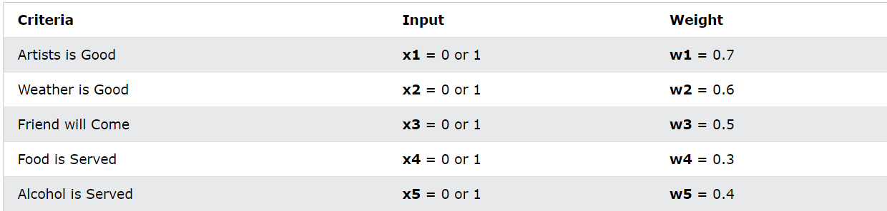
Perceptron-example
Imagine a perceptron (in your brain).
The perceptron tries to decide if you should go to a concert.
Is the artist good? Is the weather good?
What weights should these facts have?
Image taken from w3school

Slide 13
Perceptron-example
The Perceptron Algorithm:
1.Set a threshold value
2.Multiply all inputs with its weights
3.Sum all the results
4.Activate the output

Slide 14
Perceptron-example
1-Set a threshold value:
Threshold = 1.5

Slide 15
Perceptron-example
The Perceptron Algorithm:
2.Multiply all inputs with its weights:
x1 * w1 = 1 * 0.7 = 0.7
x2 * w2 = 0 * 0.6 = 0
x3 * w3 = 1 * 0.5 = 0.5
x4 * w4 = 0 * 0.3 = 0
x5 * w5 = 1 * 0.4 = 0.4

Slide 16
Perceptron-example
3. Sum all the results:
0.7 + 0 + 0.5 + 0 + 0.4 = 1.6 (The Weighted Sum)

Slide 17
Perceptron-example
4. Activate the Output:
Return true if the sum > 1.5 ("Yes I will go to the Concert“)

Slide 18
Feed-Forward Neural Networks
A Feedforward Neural Network (FNN) is a type of artificial neural network where information moves only in one direction, from the input layer through any hidden layers and finally to the output layer. This is the simplest kind of artificial neural network. There are no cycles or loops in the network. The term “feedforward” refers to the fact that the connections between the units do not form a cycle, unlike in more complex types of networks (like RNN).

Slide 19
Feed-Forward Neural Networks
In the late 1980s, FNN revival was fueled by two key developments:
1-Multi-Layer Perceptrons (MLPs)
2-Backpropagation algorithm

Slide 20
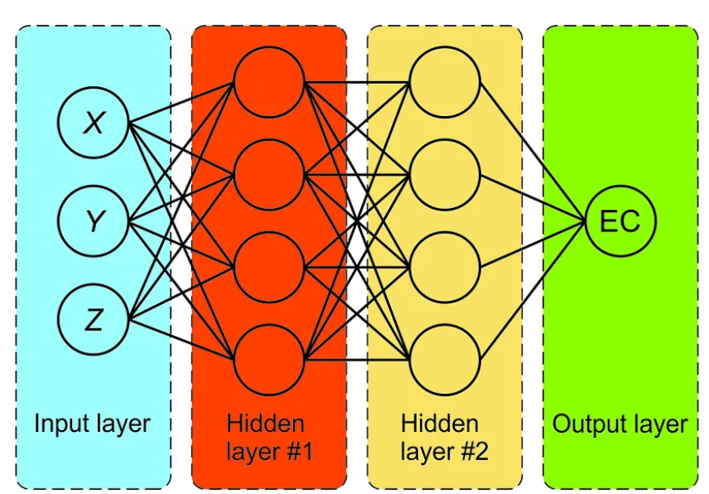
Multi-layer Perceptron (MLP)
An MLP typically consists of the following layers:
· Input layer: receives the input data
· Hidden layers: process the information and learn complex representations.
· Output layer: produces the final output based on the processed information.

Slide 21
Multi-layer Perceptron (MLP)
A Multilayer Perceptron (MLP) consists of an input layer, one or more hidden layers, and an output layer. The MLP is fully connected, in the sense that each neuron in one layer connects (with a specific weight) to every neuron in the following layer. The number of hidden layers and the number of neurons in each layer are hyperparameters that influence the model’s capacity and complexity.
Source:https://www.researchgate.net/figure/Schematic-of-a-multilayer-perceptron-network-MLP_fig6_336308377

Slide 22
Multi-layer Perceptron (MLP)
Each neuron in an MLP performs a non-linear activation function, often a sigmoid or ReLU function, to introduce non-linearity into the network. This allows MLPs to learn complex relationships — data that is not linearly separable — between input and output variables.
Source:https://www.researchgate.net/figure/Schematic-of-a-multilayer-perceptron-network-MLP_fig6_336308377

Slide 23
Backpropagation
Backpropagation, short for “backward propagation of errors,” is a critical component in training and refining neural network models. Its role is to adjust the network’s internal connections, known as weights, in order to minimize the “error” it makes during the learning process.

Slide 24
Backpropagation
The term “back-propagating error correction” was introduced in 1962 by Frank Rosenblatt. But the current method, which includes the use of gradient descent or variants such as stochastic gradient descent, was popularized by David E. Rumelhart and others.

Slide 25
Backpropagation
Backpropagation, short for “backward propagation of errors,” is a critical component in training and refining neural network models. Its role is to adjust the network’s internal connections, known as weights, in order to minimize the “error” it makes during the learning process.

Slide 26
Backpropagation
Backpropagation process relies on two key concepts:
1. Loss function: This function measures the discrepancy between the network’s output and the desired outcome. It essentially quantifies how “wrong” the network is in its predictions.
2. Gradient of the loss function: This represents the direction and magnitude of change required to minimize the error. It tells us how much and in what direction we need to adjust the weights to improve the network’s performance.

Slide 27
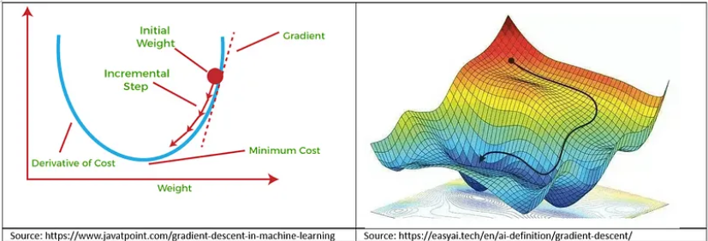
Backpropagation
The gradient of the loss function, denoted as ∇L, is a vector containing the partial derivatives of the loss function (L) with respect to each of the parameters (weights and biases) in the neural network. It acts as a guide for optimizing neural networks.

Slide 28
Backpropagation
It points in the direction in which the loss function increases the most (or the steepest increase). By adjusting the network parameters in the opposite direction (negative gradient), the loss function can be decreased, leading to improved model performance.

Slide 29
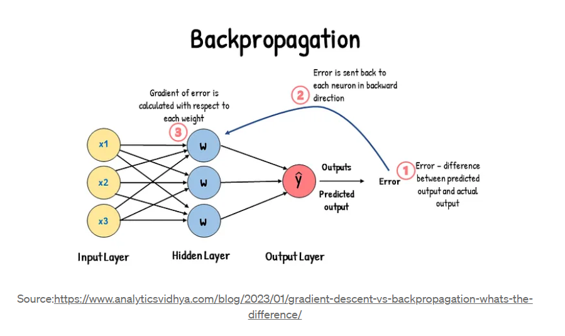
Backpropagation
Each element of the gradient represents the rate of change of the loss function with respect to the corresponding parameter. In simpler terms, it tells us how much the loss will increase or decrease if we slightly change the value of that specific parameter. For higher values of error (loss), we will have larger values of the gradient (and larger change to the associated parameter).

Slide 30
Backpropagation
Backpropagation utilizes the chain rule of calculus to efficiently calculate this gradient. This rule allows us to propagate the error backward through the network, layer by layer, ultimately determining how each weight contributes to the overall error.

Slide 31
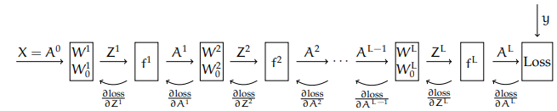

Backpropagation-formulization

Slide 32
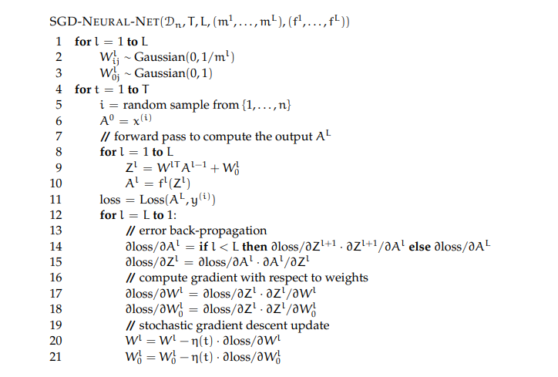
Training

Slide 33
Training
Initializing W is important; if you do it badly there is a good chance the neural network training won’t work well. First, it is important to initialize the weights to random values. We want different parts of the network to tend to “address” different aspects of the problem; if they all start at the same weights, the symmetry will often keep the values from moving in useful directions. Second, many of our activation functions have (near) zero slope when the pre-activation z values have large magnitude, so we generally want to keep the initial weights small so we will be in a situation where the gradients are non-zero, so that gradient descent will have some useful signal about which way to go.

Slide 34

Choices of activation function
There are many possible choices for the activation function. We will start by thinking about whether it’s really necessary to have an f at all. What happens if we let f be the identity? Then, in a network with L layers:

Slide 35

Choices of activation function
So, multiplying out the weight matrices, we find that
which is a linear function of X! Having all those layers did not change the representational capacity of the network. the non-linearity of the activation function is crucial.

Slide 36
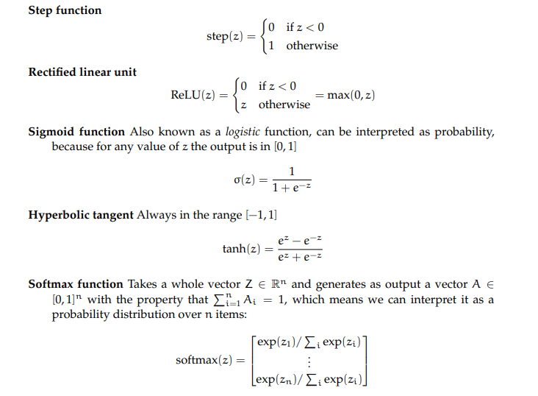
Choices of activation function

Slide 37
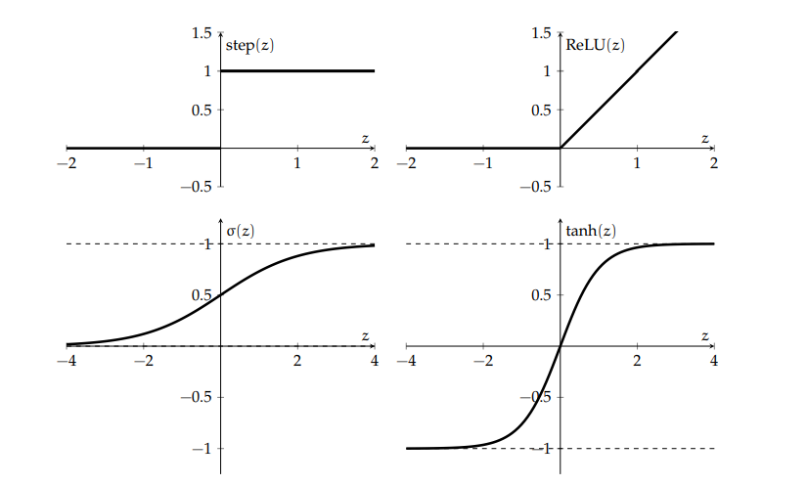
Choices of activation function

Slide 38
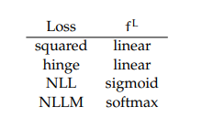
Loss functions and activation functions
Different loss functions make different assumptions about the range of inputs they will get as input and, as we have seen, different activation functions will produce output values in different ranges. When you are designing a neural network, it’s important to make these things fit together well. In particular, we will think about matching loss functions with the activation function in the last layer, f^L. Here is a table of loss functions and activations that make sense for them:

Slide 39
Numerical Example
Consider the following data set:

Slide 40
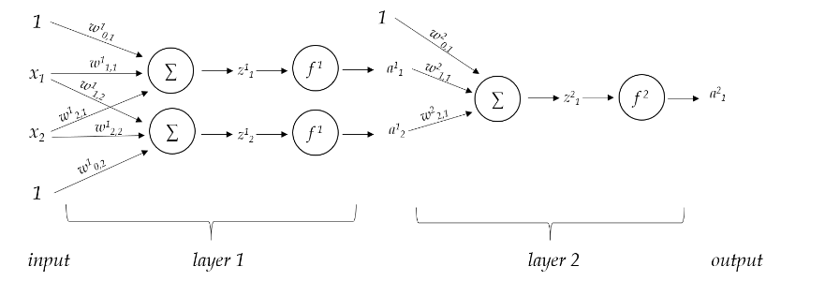
Numerical Example
The columns of X and Y are the data points and corresponding labels.
We will be looking at the behavior of the following simple two-layer network:

Slide 41


Numerical Example
Assume that within each layer, each unit has the step activation function f(z)
f(z) given by
Let the weights in the first layer (layer 1) be:

Slide 42

Numerical Example
Find matrix Z where each column represents the outputs of the hidden units :
Answer:

Slide 43
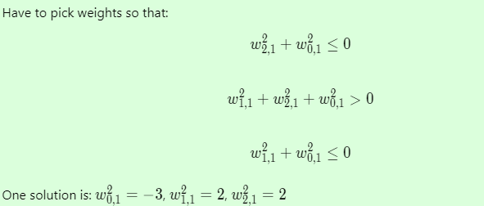
Numerical Example
Pick weights for second layer so that desired outputs are predicted correctly
Answer:

Slide 44
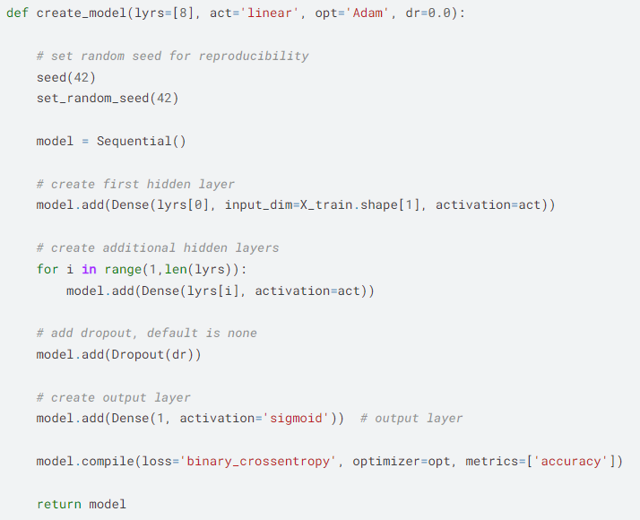
Implementation in python
We use sequential object from tensorflow.
Dense here has 3 arguments .The first one is number of neurons .The second one is our input dimension .Most of the times because the columns of our dataset are our features , we put X_train.shape[1] .the last arguments is our activation function .we have so many choices and you can search tensorflow document to see. Number of neurons in each layer is in lyrs.

Slide 45
Implementation in python
We use a loop to add other layers. We can add dropout which randomly turns off some neuron in process of training for avoiding over fitting. Based on our task our last layer’s activation and number of neuron are different. Here we have binary classification supposedly so our activation is sigmoid and we have just one neuron.

Slide 46
Implementation in python
Let’s talk about compiling the model.
Our loss function depends on our task. Here we have binary classification so we use binary cross entropy.
We have so many options for optimizers. We can use gradient descent .Here we use Adam.

Slide 47

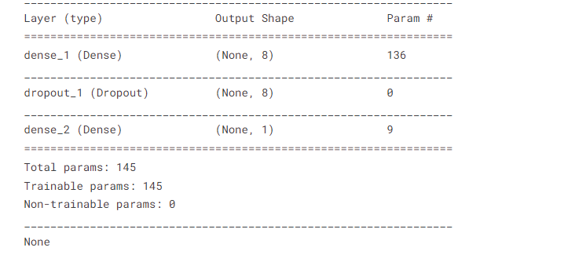
Implementation in python
Let’s create the model . We can use model.summary() to see our model.

Slide 48
Implementation in python
At last we train the model
Here we pass our training set and splitting happens in training phase. We do training for 100 epochs. Verbose is 0 means that we don’t see each step training. Batch size is number of sample in each of our Batches.
Training is a history. We can do many things with it including showing our accuracy and loss!

Slide 49
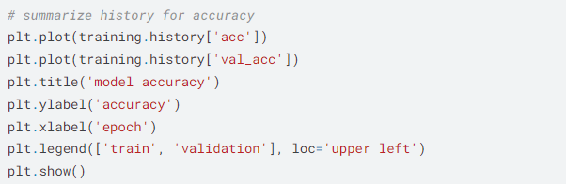
Implementation in python
Let’s see how we can see accuracy(for seeing loss just write loss instead of accuracy in code.)

Slide 50
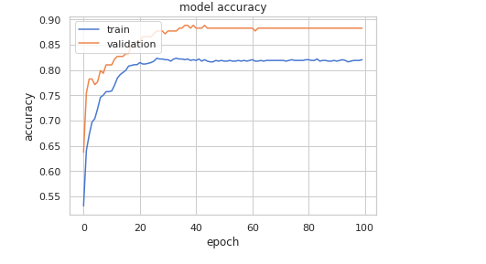
Implementation in python
We can get a output like this:

